Slide 1
Drug designer database
Carlos Dominguez(Developer, Tester, scrum master, everything…) Product Owner: Dr. Luis Arroyo

Slide 2
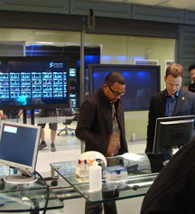
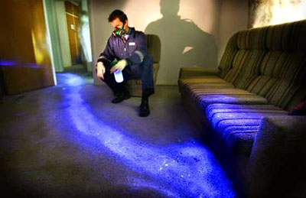
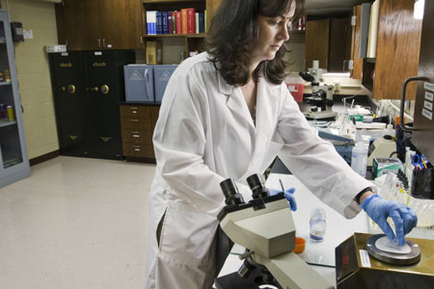
Presentation
What’s my project about?

Slide 3
Stories in spring 4
User Story | Estimated | Current
#201 email defect | 4 | 4
#202 pictures name defect | 4 | 5
#203 import defect | 16 | 14
#204 update about us page | 4 | 3
#205 change look of the system | 16 | 17
 | 44 | 43 | Total
43 ---- = 1.08 points per hour 40
Total Speed =

Slide 4
Mingle Daily Scrum
Daily Scrum # | Date | Action
237 | 23/3/2015 | Pictures Defect | 4hrs
238 | 24/3/2015 | Pictures Defect Import Defect | 1 hr 3 hrs
239 | 25/3/2015 | Import Defect | 4 hrs
240 | 26/3/2015 | Import Defect | 4 hrs
241 | 27/3/2015 | Import Defect Change look of the system Meet with client | 1 hrs 5 hrs 1 hr
242 | 30/3/2015 | Change look of the system | 4 hrs
243 | 31/3/2015 | Change look of the system | 4 hrs
244 | 01/4/2015 | Change look of the system | 4 hrs
245 | 02/4/2015 | Update about us page | 4 hrs
246 | 03/4/2015 | Pictures name defect Meet with client | 5 hrs 2 hrs

Slide 5
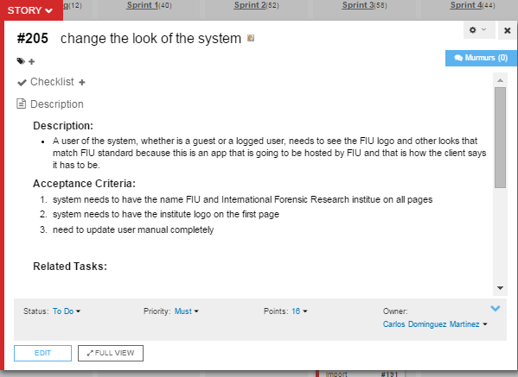
Change look of the System User Story

Slide 6
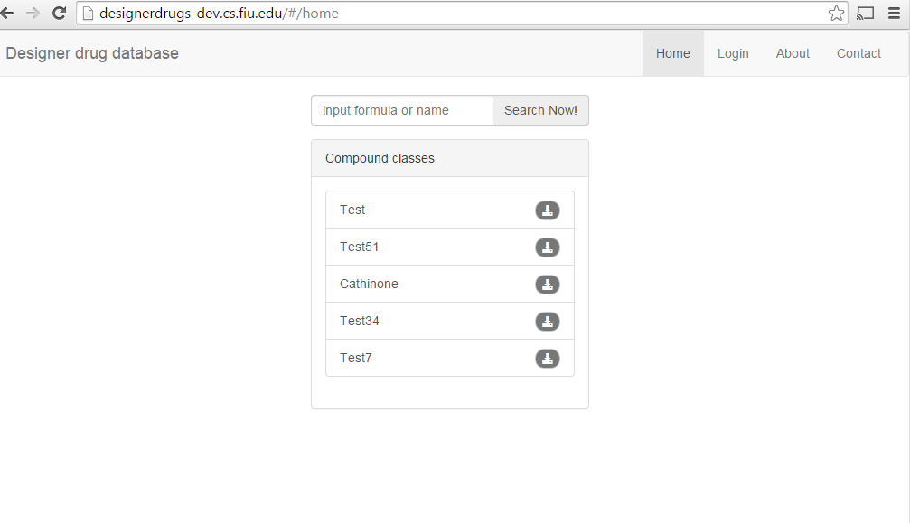
This is how it looked before

Slide 7
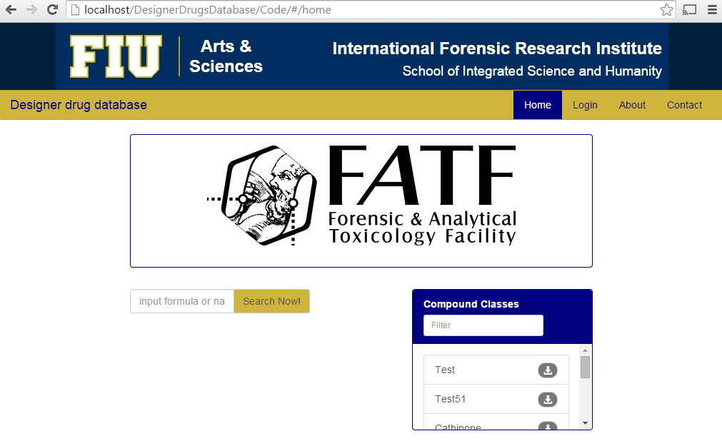
This is how it looks now

Slide 8
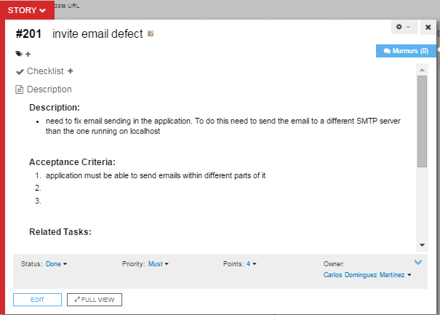
Invite Email Defect User Story

Slide 9
Invite email Use Case
Name: 175_createUser
Participating actor: admin user
Entry condition: User is logged in the system User is in the User Management page. User has admin rights
Exit condition: User invite is sent
Event flow: User enter the email of the user to be invited User clicks the invite button. System confirms that the invitation has been sent.

Slide 10
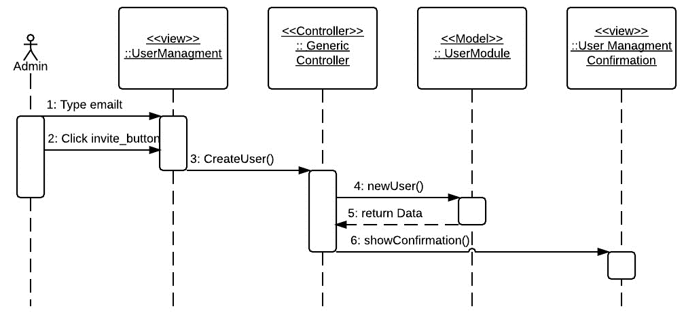
Invite new user sequence Diagram

Slide 11
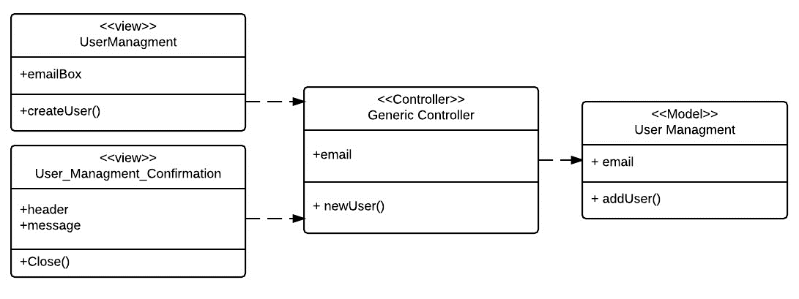
Class diagram

Slide 12
DEMO

Slide 13
Documents updated
Feasibility Study
Required Documents
Design Document
User Manual
Installation guide

Slide 14
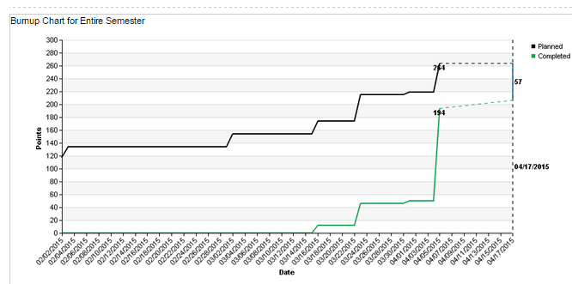
BurnUP Chart

Slide 15
Current Sprint
User Story | Estimated | Accepted
#201 import defect | 4 | 4
#202 add compound defect | 4 | 4
#203 compound info defect | 16 | 16
#204 edit compound defect | 8 | 8
 | 32 | 32

Slide 16
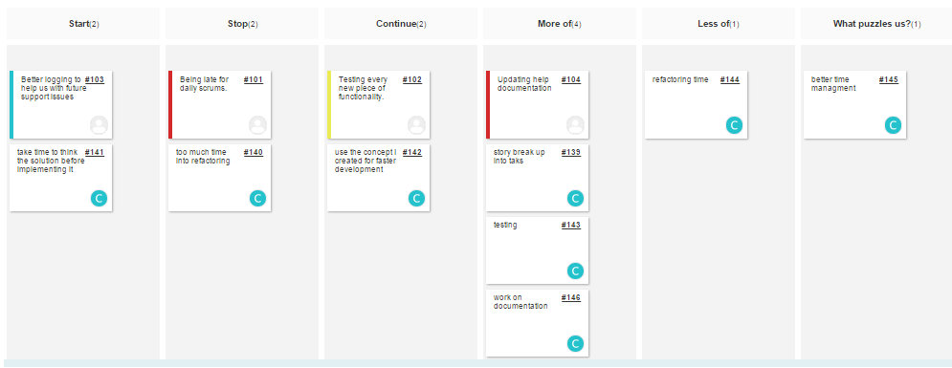
Retrospective

